Slide 1
DESIGN AND DEVELOPMENT OF VIRTUAL LABS FOR CONTROL SYSTEMS APPLICATIONS
AYUSH KHANDELWAL (14EE111)
MARREDDY SRIYELLA(14EE223)
SNIGDHA CHALASANI(14EE241)
SYED ARSAL HUSSAIN(14EE250)

Slide 2

NOTEPAD ++
She was able to design a number of experiments that could carry out stability analysis of the systems, characterize the systems, plot system responses, etc. via Virtual Labs.
Notepad++ is a text editor and source code editor for use with Microsoft Windows. It supports tabbed editing, which allows working with multiple open files in a single window.
Notepad++ helped us to alter the html files for the web pages thus making it easier to manipulate them according to our requirements.
Some of programming languages that are natively supported by Notepad++ are as follows:
C,C++,C#,Javascript,SQL, Verilog , Python, MATLAB and many more.

Slide 3
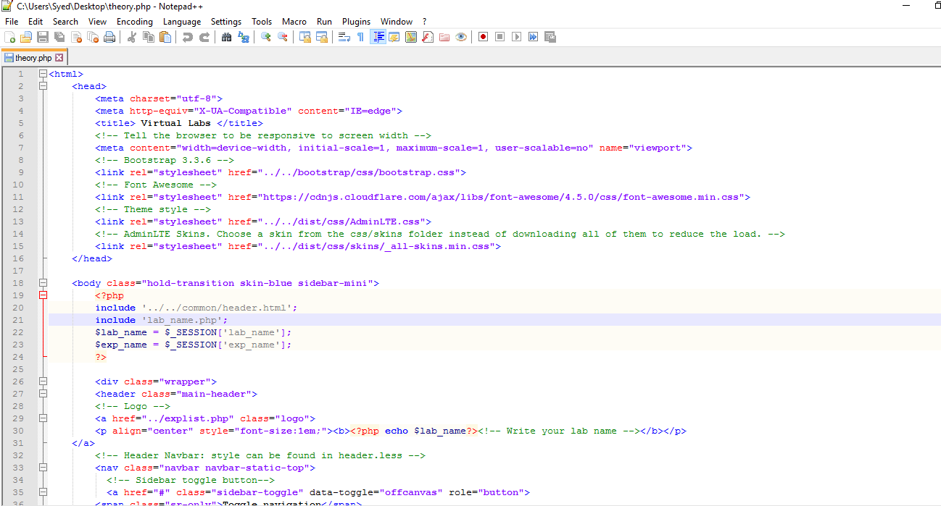
Notepad ++ Environment :

Slide 4

WAMP SERVER
Wamp Server is a Windows web development environment. It allows us to create web applications with Apache2, PHP and a MySQL database. It also comes with PHPMyAdmin and SQLiteManager to easily manage our databases.
Wamp Server installs automatically (installer), and its usage is very intuitive.
Wamp Server was used to load the web page development on to our local server which in turn helped us to manage our files and manipulate them accordingly.

Slide 5
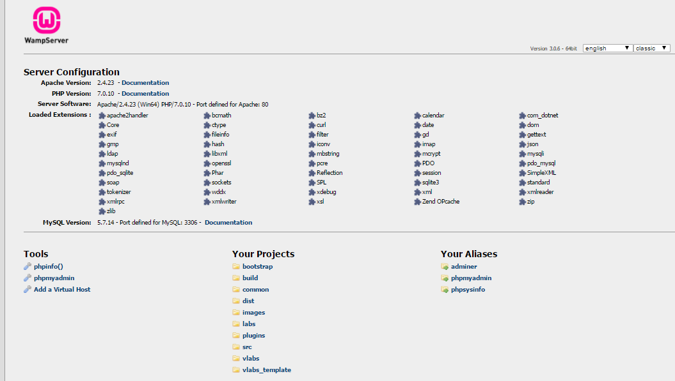
Wamp Server :

Slide 6
CHARACTERIZATION OF INPUT-OUTPUT RELATIONS OF CONTROL SYSTEMS
–EXPERIMENT 1

Slide 7
CAUSAL, NON-CAUSAL AND ANTICAUSAL SYSTEMS
In control theory, a causal system (also known as a physical or nonanticipative system) is a system where the output depends on past and current inputs but not future inputs—i.e., the output depends only on the input.
A system that has some dependence on input values from the future (in addition to possible dependence on past or current input values) is termed a non-causal or acausal system.
A system that depends solely on future input values is an anticausal system.
The causality of systems also plays an important role in digital signal processing, where filters are constructed so that they are causal, sometimes by altering a non-causal formulation to remove the lack of causality so that it is realizable.

Slide 8
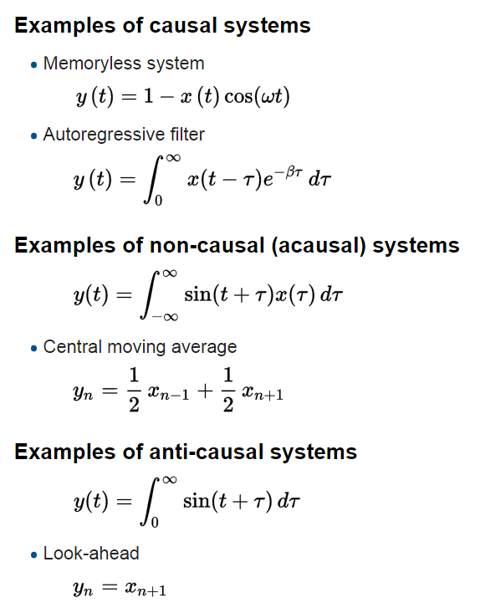

Slide 9
TIME-VARIANT AND TIME-INVARIANT SYSTEMS
A time-invariant (TIV) system is a system whose output does not depend explicitly on time. Such systems are regarded as a class of systems in the field of system analysis. Lack of time dependence is captured in such cases.
A system in which certain quantities governing the system's behaviour change with time, so that the system will respond differently to the same input at different times is a time-variant system.
Examples:
Time variant systems: Linear time varying processes such as amplitude modulation occur on a time scale similar to or faster than that of the input signal.
Time invariant systems: No man-made electronic system is time invariant in the strict sense. However, for the duration of a compact disc, if you leave the volume fixed, the system can be reasonably approximated as being time invariant.

Slide 10
LINEAR AND NON-LINEAR SYSTEMS
Linear control theory applies to systems made of linear devices; which means they obey the superposition principle; the output of the device is proportional to its input. Systems with this property are governed by linear differential equations.
Nonlinear control theory is the area of control theory which deals with systems that are nonlinear, time-variant, or both.
Linear time invariant (LTI) systems are amenable to powerful frequency domain mathematical techniques of great generality, such as the Laplace transform, Fourier transform, and Z transform, root-locus, Bode plot, and Nyquist stability criterion.

Slide 11
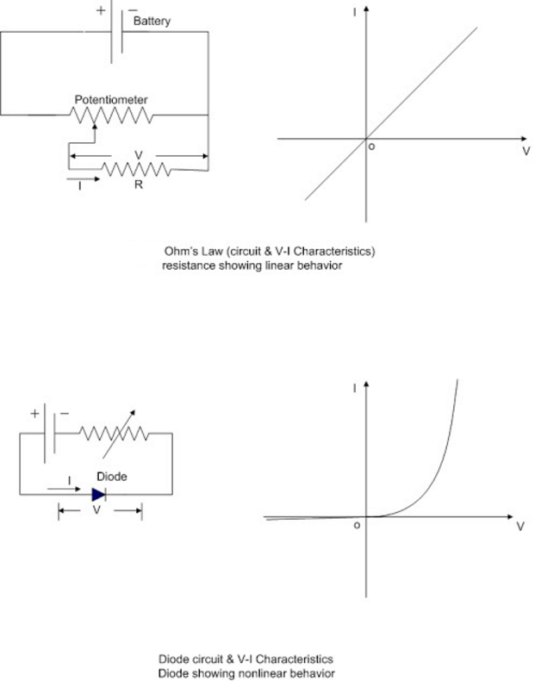

Slide 12
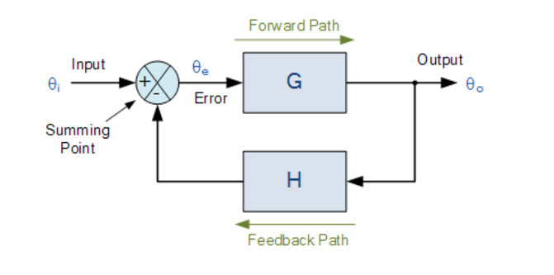
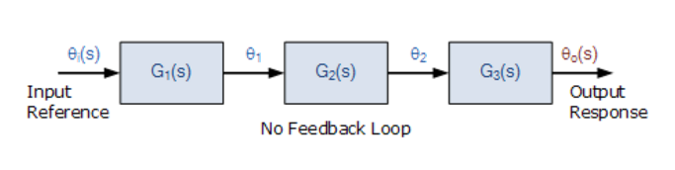
OPEN LOOP AND CLOSED LOOP CONTROL SYSTEMS
An open loop control system acts completely on the basis of input and the output has no effect on the control action.
A closed loop control system considers the current output and alters it to the desired condition. The control action in these systems is based on the output.
BLOCK DIAGRAMS OF OPEN LOOP AND CLOSED LOOP SYSTEMS

Slide 13
STABLE AND UNSTABLE SYSTEMS
Considering any bounded input signal of a system, and if the output signal of the system to such a signal is also bounded, then the system is called bounded-input-bounded-output stable.
Systems without this property can be termed as unstable.

Slide 14
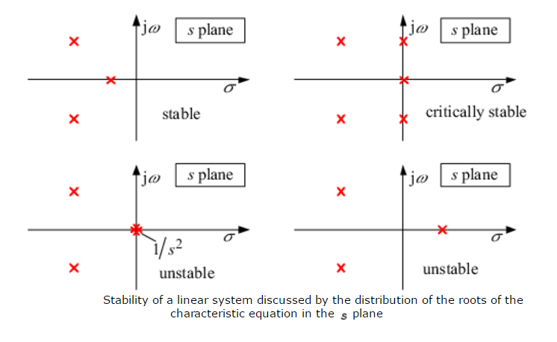
To test the stability the following necessary and sufficient criterion have been formulated :
Asymptotic stability:
A linear system is only asymptotically stable, if the real part of the roots of the characteristic equation of a system are less than zero, or in other words, if all poles of its transfer function lie in the left-half of the s-plane.
Instability:
linear system is only unstable, if at least one pole of its transfer function lies in the right-half of the s-plane or, if at least one multiple pole is on the imaginary axis of the s-plane.
Critical stability:
A linear system is critically stable, if at least one single pole exists on the imaginary axis, no pole of the transfer function lies in the right-half of the s-plane and in addition no multiple poles lie on the imaginary axis.

Slide 15
MEMORYLESS AND NON-MEMORYLESS SYSTEMS
Memoryless systems the output signal at each time depends only on the input at that time. The previous values or future values of the input are not required in order to determine the current value of the output. The systems which do not have this property are named as non-memoryless systems.
Static systems are memory less whereas dynamic systems are with memory containing systems.

Slide 16
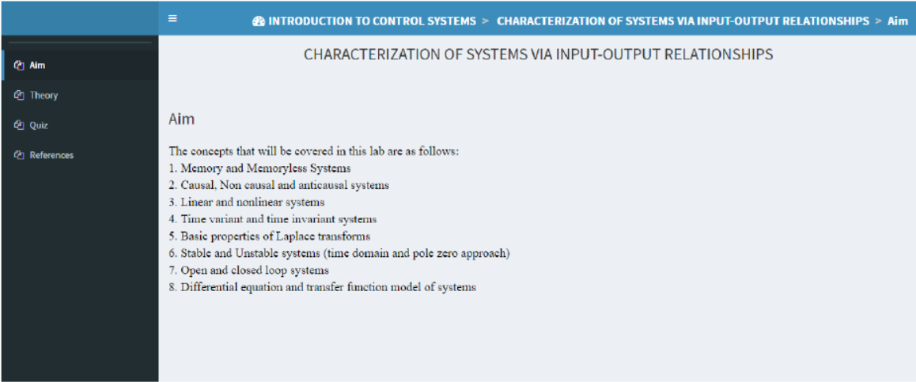
SCREENSHOTS

Slide 17
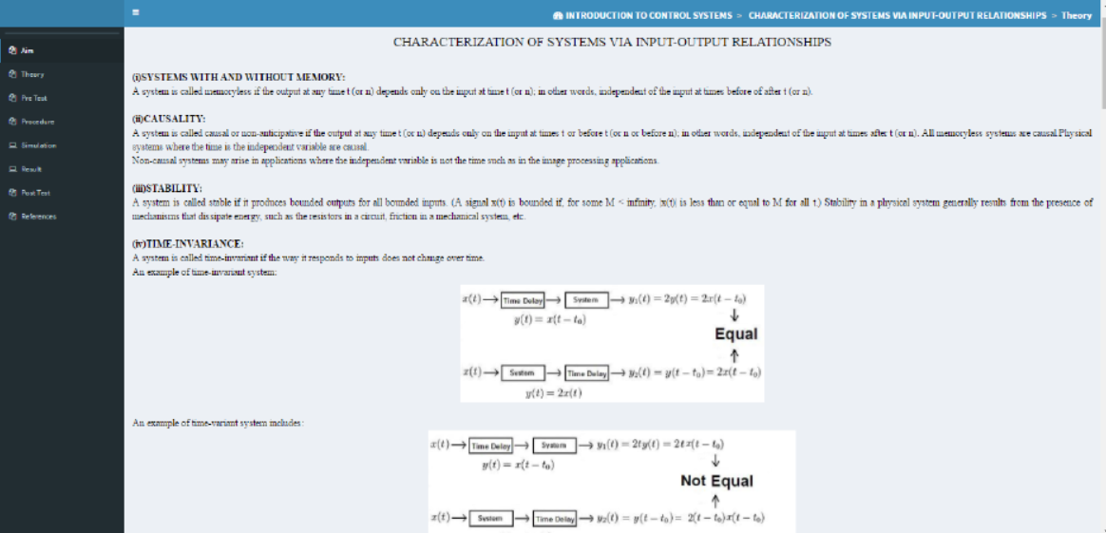

Slide 18
RC CIRCUIT RESPONSE – EXPERIMENT 2
AIM
The aim of the RC circuit response experiment was to plot the current across the capacitor when a step excitation input was given with initial conditions. In this experiment we have
developed:
Objective
Theory
Simulation,
Quizzes,
References &
MATLAB Simulation.

Slide 19
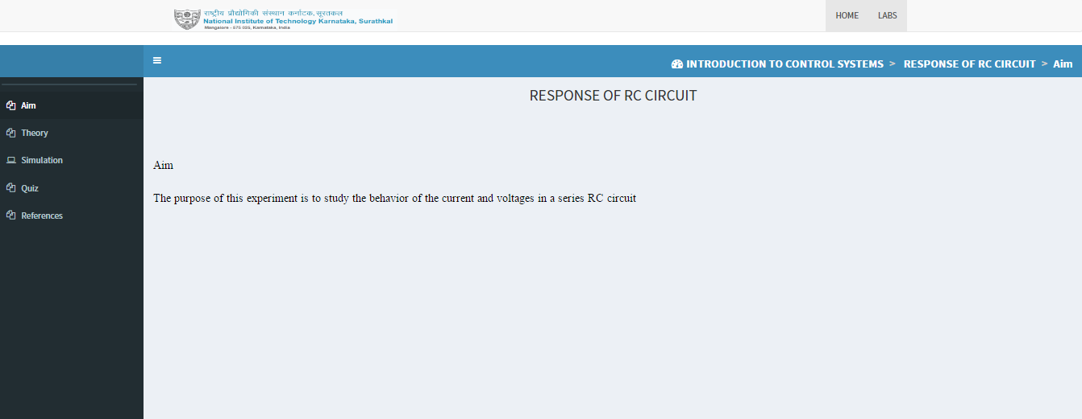
SCREENSHOTS

Slide 20
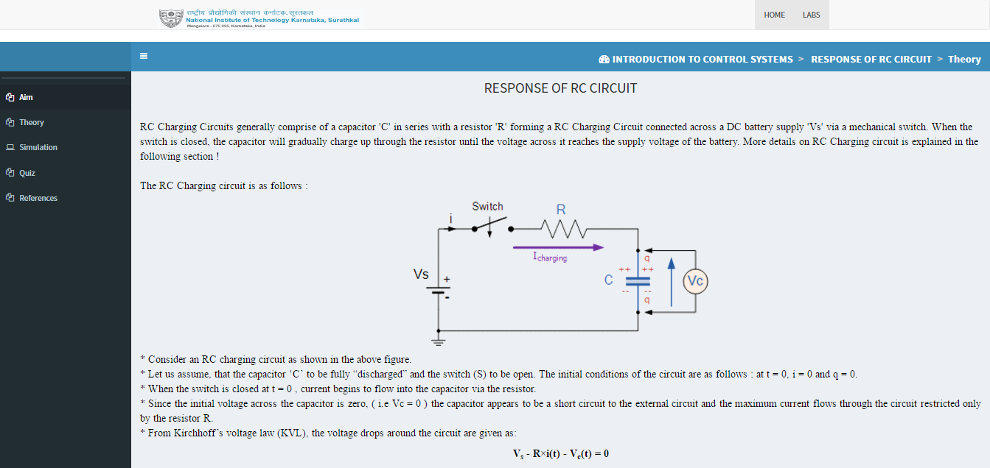

Slide 21
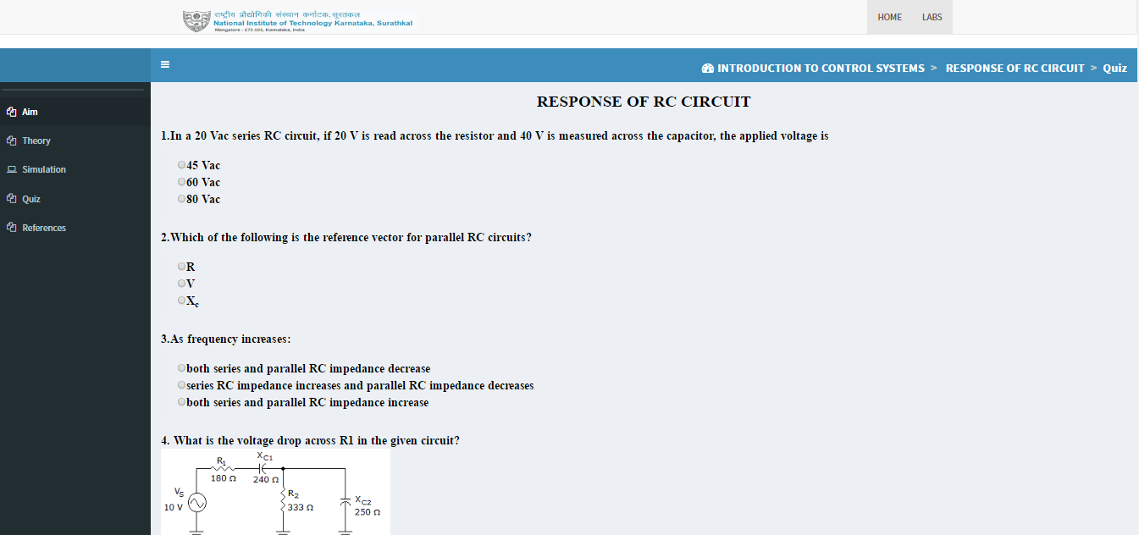

Slide 22
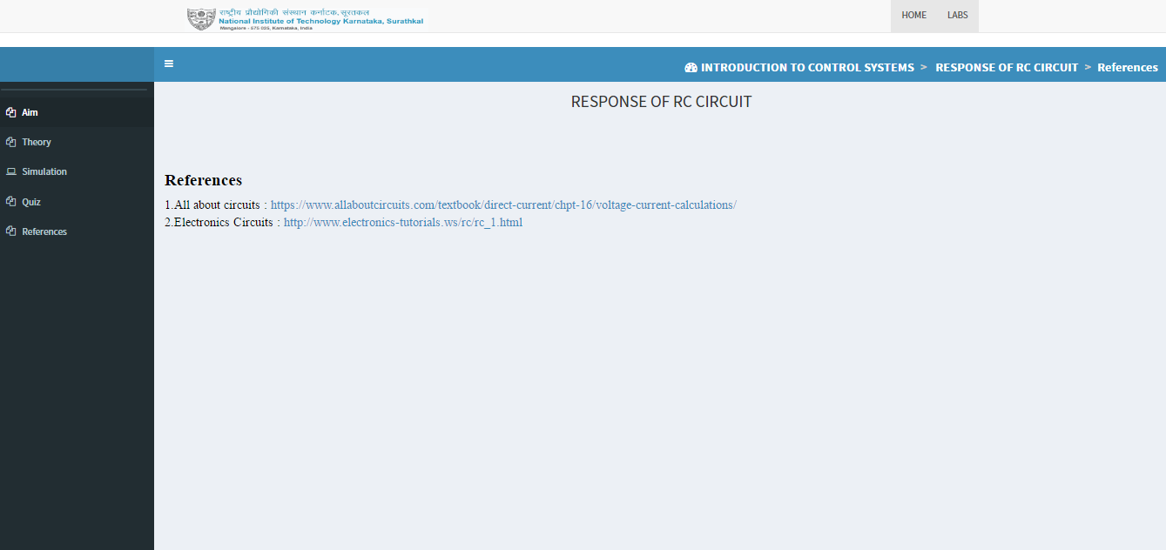

Slide 23
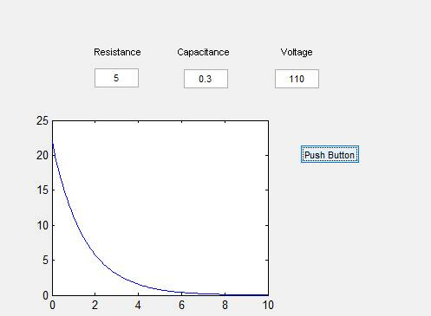
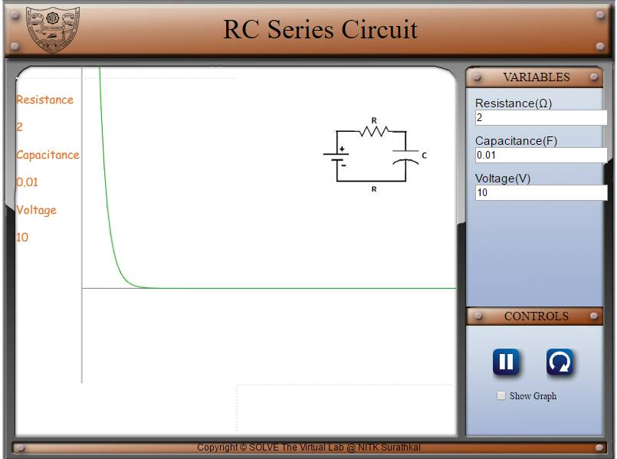
1st order RC Circuit
Current (A)
Time (s)

Slide 24
RL CIRCUIT RESPONSE – EXPERIMENT 3
AIM
The aim of the RL circuit response experiment was to plot the voltage build up across the inductor when a step excitation input was given with initial conditions. In this experiment we have
developed:
Objective ,
Theory ,
Simulation,
Quizes,
References &
MATLAB Simulation.

Slide 25
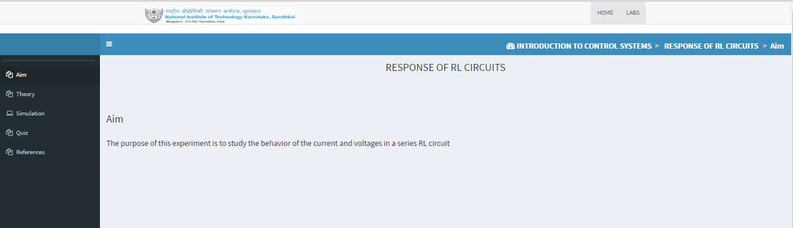
SCREENSHOTS

Slide 26
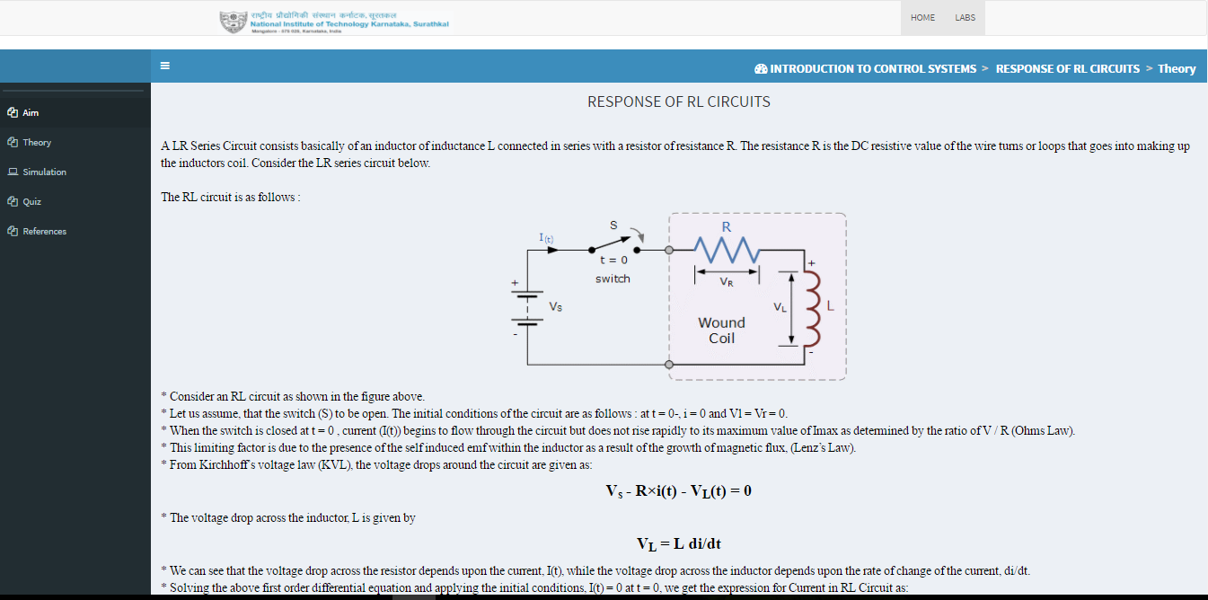

Slide 27
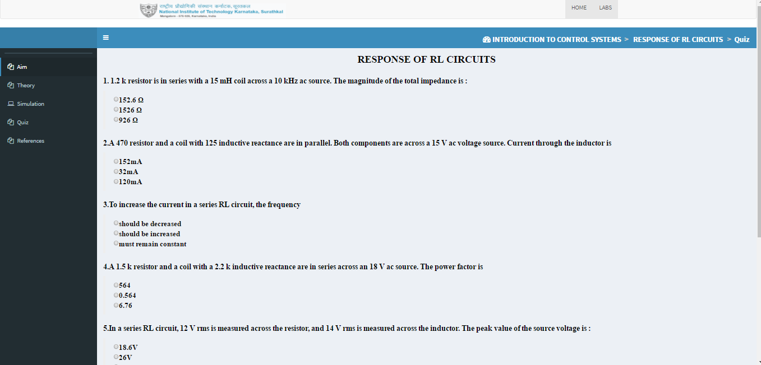

Slide 28
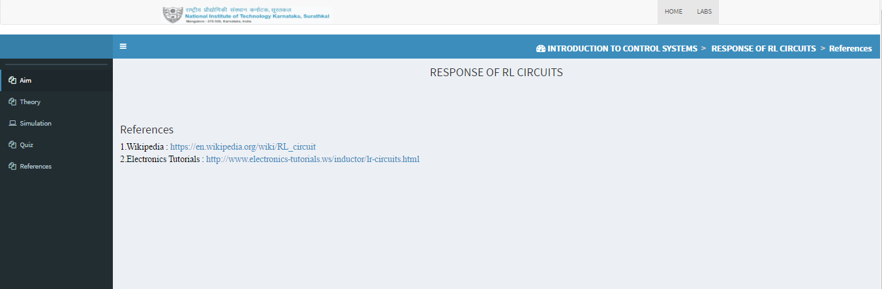

Slide 29
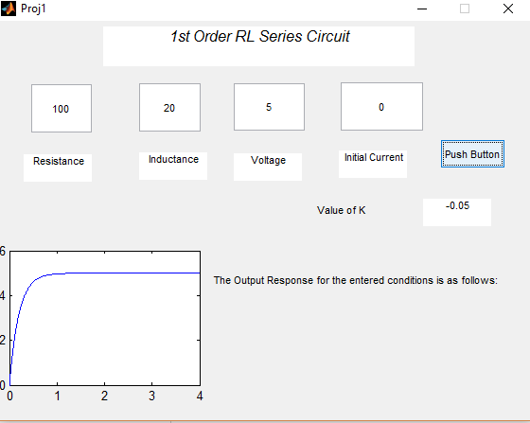
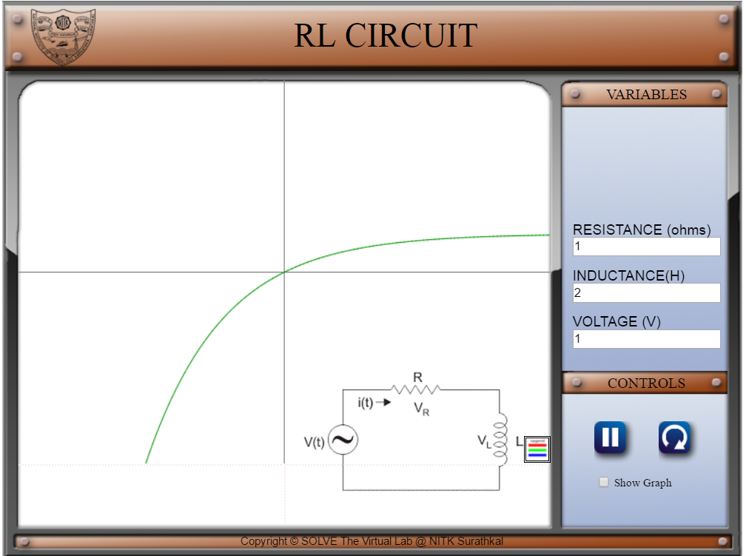

Slide 30
ROUTH HURWITZ ALGORITHM – EXPERIMENT 4
AIM
The aim of the Routh Hurwitz algorithm experiment was to develop an algorithm that can detect whether a system is stable or unstable depending on the transfer function entered. In this experiment we have developed:
Objective ,
Theory ,
Simulation,
Quizzes,
References &
MATLAB Simulation

Slide 31
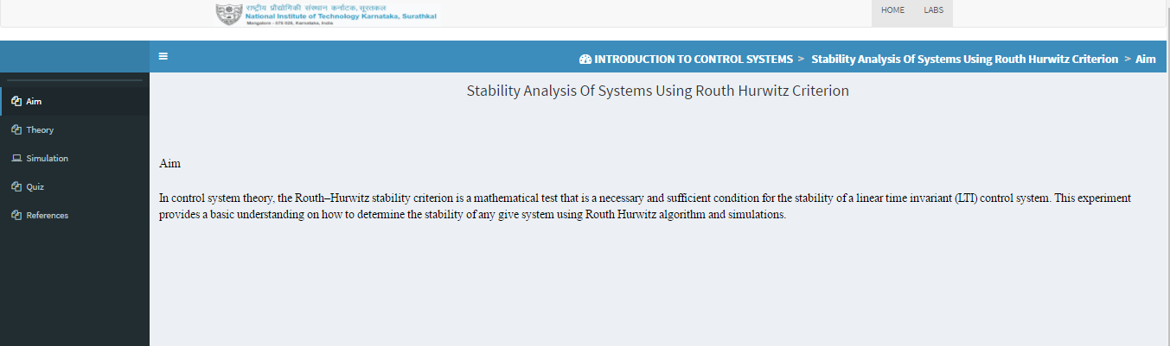
SCREENSHOTS

Slide 32
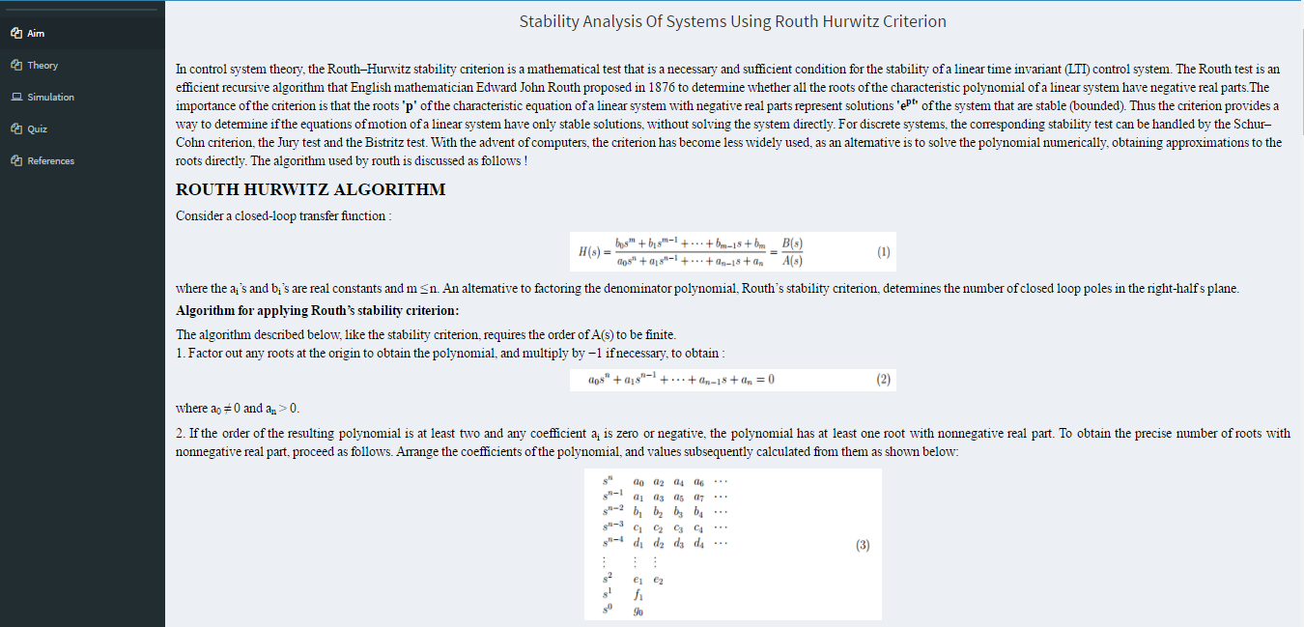

Slide 33
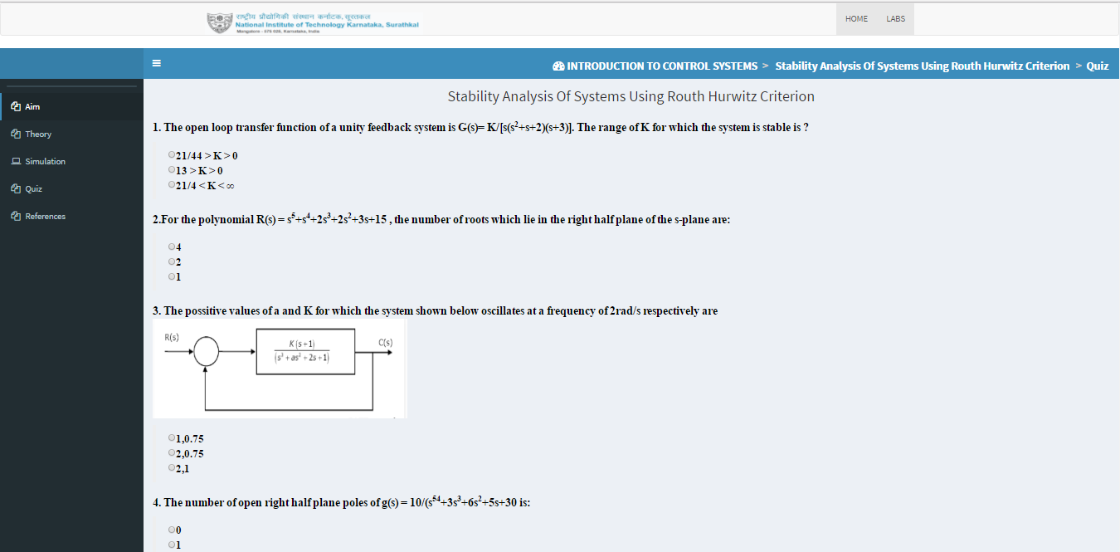

Slide 34
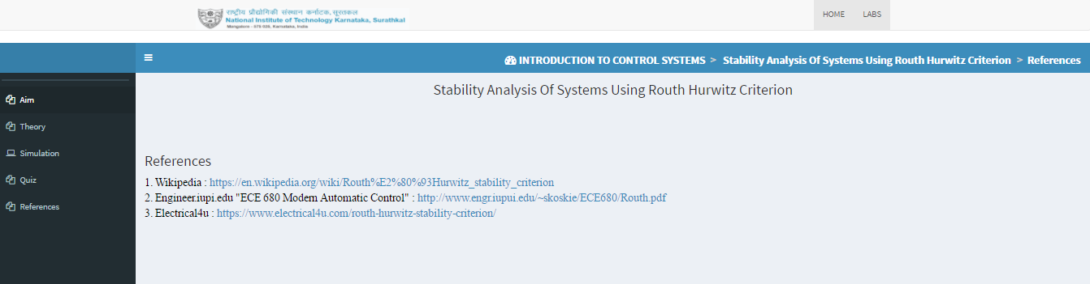

Slide 35
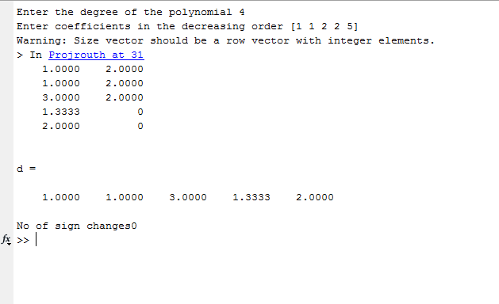

Slide 36
SECOND ORDER SYSTEMS
-EXPERIMENT 5

Slide 37

The largest difference between the linear and second order systems is that in second order systems , oscillations and overshoot can now be exhibited in their natural frequency response.
Second order behaviour is part of the behaviour of higher order systems and understanding second order systems helps us to understand higher order systems.
There can be various examples for second order systems including electrical, mechanical, thermal, fluid systems, etc. The order of a control system is determined by the power of s in the denominator of its transfer function. If the power of s in the denominator of transfer function of a control system is 2, then the system is said to be second-order control system.
A transient response or natural response is the response of a system to a change from an equilibrium or a steady state.
The general expression of transfer function of a second order control system is given as
Where C(s) is the output and R(s) is the input to the system.
Here, ζ and ω_{n} are damping ratio and natural frequency of the system respectively. There will be different behaviours of output signal, depending upon the value of damping ratio. Using the laplace transforms we get the following equations:
For undamped system (ζ=zero ), the unit step response observed is:

Slide 38



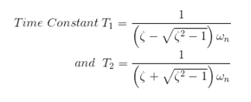
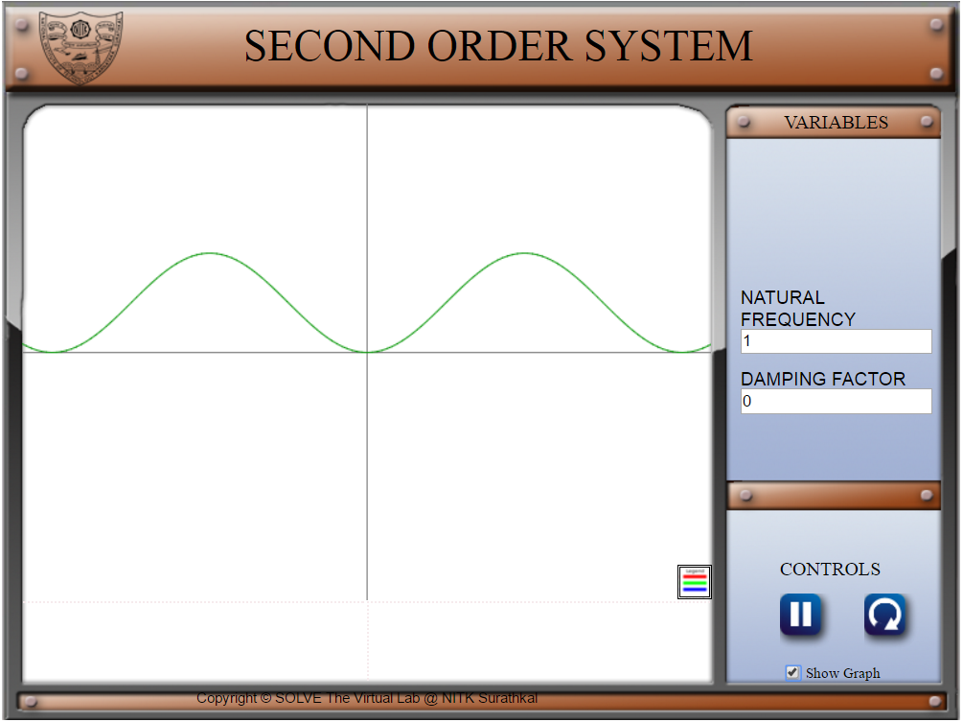
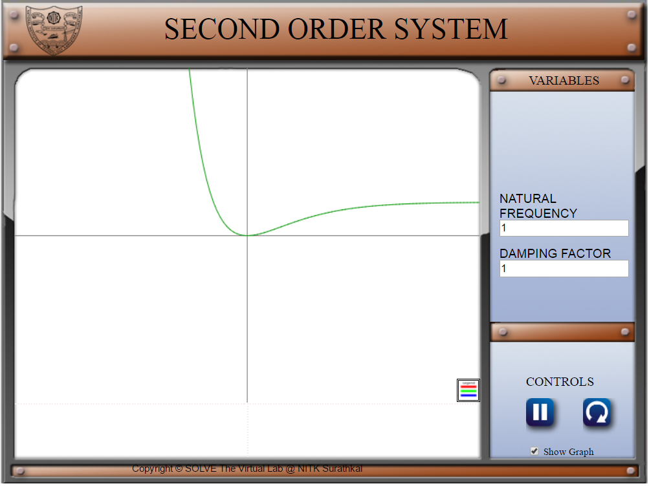
For underdamped system (ζ<1 ), the unit step response observed is:
For critically damped system (ζ=1 ), the unit step response observed is:
For overdamped system (ζ>1 ), the unit step response observed is:
Examples of the simulations observed with the use of HTML, JavaScript and jQuery :

Slide 39
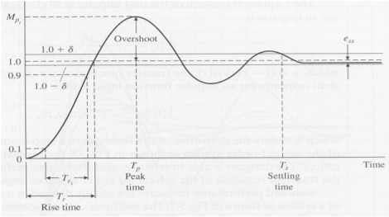
STANDARD PERFORMANCE MEASURES OF SECOND ORDER SYSTEMS
Performance measures are usually defined in terms of the step response of a system as below:
Peak time:
The peak time is the time required for the response to reach
the first peak of the overshoot.
2. Rise time:
Rise time refers to the time required for a signal to change
from a specified low value to a specified high value. Typically,
these values are 10% and 90% of the step height.
3. Steady state error:
Steady-state error of a system is the difference between the
desired final output and the actual one" when the system reaches a steady state, when its behavior may be
expected to continue if the system is undisturbed.
4. Settling time:
The settling time is the time required for the output to reach within a certain percentage of the amplitude of
the response.
Percentage of overshoot:
Percentage overshoot measures the closeness of the response to the desired output.
Swiftness of the response is measured by rise time and peak time.
For underdamped system, the Rise time is useful whereas for the overdamped systems, the Peak time is not defined.

Slide 40
PID CONTROL
- EXPERIMENT 6

Slide 41


PID control is by far the most common way of using feedback in natural and man-made systems.The ideal version of the PID controller is given by the formula :
where u is the control signal and e is the control error (e = r − y). The reference value, r, is also called the setpoint. The control signal is thus a sum of three terms: a proportional term that is proportional to the error, an integral term that is proportional to the integral of the error, and a derivative term that is proportional to the derivative of the error. The controller parameters are proportional gain kp, integral gain ki and derivative gain kd.
The controller can also be parameterized as:
where Ti is the integral time constant and Td the derivative time constant.

Slide 42
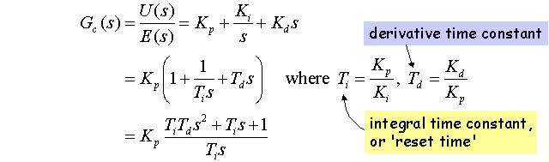
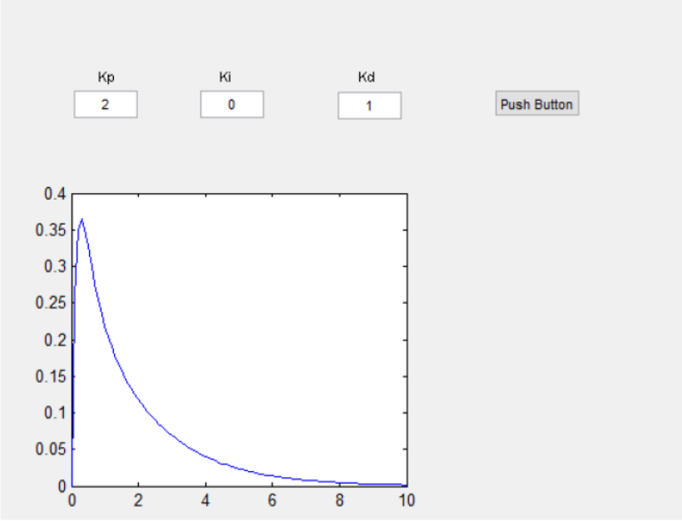
The transfer function of a PID Controller is given as:
Example of a MATLAB simulation for PID Control:

Slide 43
THANK YOU

